Slide 1
INF130
Lage og bruke tabeller

Slide 2
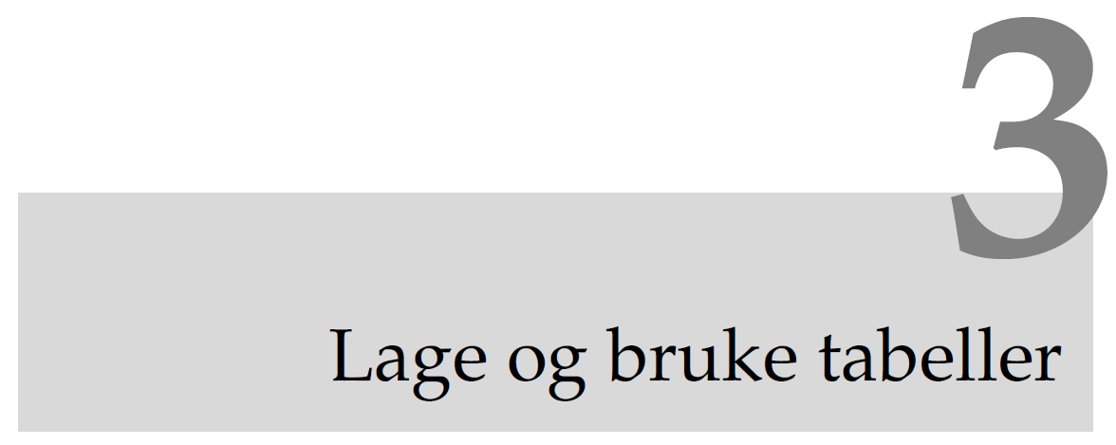

Slide 3
Goals
Understand how tables are constructed in columns and rows, which role types of data, primary keys, foreign keys and business rules play to guarantee good data quality
Use SQL to define tables with data types, primary keys, foreign keys and business rules
Use SQL to work with the content of tables, insert, change and delete rows
Make SQL script that creates tables and inserts data

Slide 4
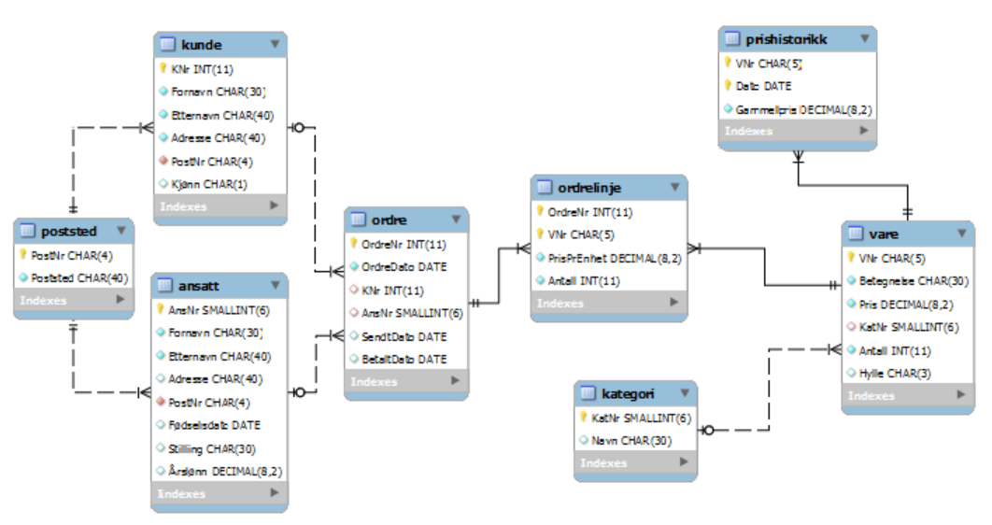
A database contains many tables
Hobbyhuset

Slide 5
The table ”Vare”
VNr | Betegnelse | Pris | Kategori | Antall | Hylle
90693 | Marsipantang | 57.00 | Konditor | 0 | B17
44939 | Malerskrin, 6 farger | 115.00 | Hobbymaling | 2 | B02
10830 | Nisseskjegg, 30 cm | 57.50 | Dukker | 42
64551 | Hengebegonia, 10 stk | 118.00 | Blomster | 206 | E05
15217 | Kram tørrfluekorker | 32.00 | Fiske | 213 | B42
90164 | Lakrisekstrakt, 100g | 75.50 | Konditor | 104 | B06
15207 | Antron garn, hvit | 24.50 | Fiske | 21 | B41
13001 | Glasskuler, 100 gr | 38.00 | Dukker | 0 | E11
15211 | Tubeflueverktøy | 209.00 | Fiske | 39 | B42
33045 | Blomkarse | 17.50 | Blomster | 206 | E05
55130 | Moro med marsipan | 298.50 | Bøker | 140 | C20
42615 | Gipsform marihøner | 106.00 | Keramikk | 124 | B03
Row, column value, data type, primary key, null mark
Can we avoid writing the same text for ”Kategori” several times?

Slide 6
The tables ”Vare” and ”Kategori”
KatNr | Kategori
1 | Blomster
2 | Bøker
3 | Konditor
4 | Hobbymaling
5 | Keramikk
6 | Dukker
7 | Fiske
VNr | ... | KatNr | ...
90693 | ... | 3 | ...
44939 | ... | 4 | ...
10830 | ... | 6 | ...
64551 | ... | 1 | ...
15217 | ... | 7 | ...
90164 | ... | 3 | ...
15207 | ... | 7 | ...
13001 | ... | 6 | ...
15211 | ... | 7 | ...
33045 | ... | 1 | ...
55130 | ... | 2 | ...
42615 | ... | 6 | ...
Table of categories
Primary key
Avoids misspellings
Saves storage

Slide 7
Student
SNr | FNr | Fornavn | Etternavn | Studium | Start
071234 | 12016711111 | Per | Lie | Informatikk | 2007
072341 | 29029622222 | Kari | Hansen | Økonomi | 2007
067234 | 18057644444 | Lise | Andersen | Informatikk | 2006
048231 | 03116033333 | Ola | Klausen | Historie | 2006
079021 | 10104766666 | Hanne | Jensen | Idrett | 2007
063288 | 24097788888 | Gro | Aslaksen | Innovasjon | 2007
031253 | 31038155555 | Åge | Hansen | Revisjon | 2005
075199 | 04099900000 | Kari | Larsen | Innovasjon | 2007
SNr (studentnr) and FNr (fødselsnr) are both candidate keys
We choose one candidate key as primary key

Slide 8
Vehicle
RegNr | Merke | Modell | År | Km
LY 12345 | Toyota | Corolla | 1998 | 225501
NV 54321 | Toyota | Avensis | 2007 | 15238
DA 98765 | Ford | Focus | 2004 | 47624
NV 67890 | Nissan | Micra | 2005 | 31092
For some objects an established primary key exist in ”the real world” – a natural key
Example: ISBN for books, birth number (norwegian fødselsnummer) for persons
For other objects we can introduce a surrogat key («løpenr»).

Slide 9
Primary keys and foreign keys
A primary key is one (or several) columns which is used to identify rows in the table
No repetitions
No null values
A foreign key is a «reference» to the primary key in another table
All values in the foreign key shall also exist in the primary key

Slide 10
Composed objects: Order and Order line
Think about a scheme for orders
The scheme consists of a «head» (date, customer number (kundernr), …)
OrdreNr | Ordredato | KNr
20505 | 20.8.2006 | 5022
20506 | 20.8.2006 | 5009
20507 | 20.9.2006 | 5188
…and a number of «lines», (object number (VNr), antall,…)
There is a one-to-many relation between orders and order lines
Primary key?
Foreign key ?
OrdreNr | VNr | Pris | Antall
20505 | 10830 | 29.90 | 1
20505 | 77033 | 109.50 | 5
20506 | 10830 | 29.90 | 1
20506 | 44939 | 57.60 | 3
20506 | 65081 | 109.50 | 5
20507 | 12088 | 109.50 | 2

Slide 11
Create tables with SQL
Before we can enter and extract data from a table we need to define its structure
Commands for table structure:
Define/create: CREATE TABLE Ansatt …
Change structure: ALTER TABLE Ansatt …
Delete: DROP TABLE Ansatt

Slide 12
Data types
SQL defines a set of data types, such as:
CHAR(n) - e.g., CHAR(30)
VARCHAR(n) - e.g., VARCHAR(30)
INT
SMALLINT
NUMERIC(p,s) - e.g., NUMERIC(5,2)
FLOAT
DATE
BOOLEAN
Some systems offer several data types. Example:
CURRENCY in Access

Slide 13
Create table with SQL
CREATE TABLE Vare
(
VNr CHAR(5),
Betegnelse VARCHAR(30),
Pris DECIMAL(8,2),
KatNr SMALLINT,
Antall INT,
Hylle CHAR(3),
PRIMARY KEY (VNr),
FOREIGN KEY (KatNr)
REFERENCES Kategori (KatNr)
);

Slide 14
Null values, repetitions and standard values
NOT NULL means that the columns has to be filled out, UNIQUE prevents equal values, and DEFAULT is used to define standard values
CREATE TABLE Student
( StudNr CHAR( 6 ),
FodselsNr CHAR( 11 ) UNIQUE NOT NULL,
Fornavn VARCHAR(15) NOT NULL,
Etternavn VARCHAR(40) NOT NULL,
PrivatEpost VARCHAR( 40 ) UNIQUE,
Status VARCHAR(15) DEFAULT 'Aktiv',
CONSTRAINT StudentPK PRIMARY KEY ( StudNr )
)

Slide 15
Foreign keys
Example: Legal values for a column ”Status” in the table ”Student” can be «Aktiv», «Permisjon» and «Sluttet».
We can use code and foreign keys
StudNr | Status
121234 | A
124321 | A
073344 | S
... | ...
Kode | Beskrivelse
A | Aktiv
S | Sluttet
P | Permisjon
... | ...

Slide 16
Rules for change and delete
To delete a customer: Set null in ”Ordre”. KNr for the customers order.
To change customer number (kundenummer) in ”Kunde”: Change kundenummer i Ordre. KNr likewise.
CONSTRAINT KundeOrdreFN
FOREIGN KEY (KNr)
REFERENCES Kunde (KNr)
ON DELETE SET NULL,
ON UPDATE CASCADE
Other possibilites:
RESTRICT (gives error message)
SET DEFAULT (inserts the default value)

Slide 17
Work with content in tables
INSERT - inserts new rows
UPDATE - makes changes in existing rows
DELETE - deletes selected rows
INSERT comes in 2 variants: add 1 row / add many
UPDATE and DELETE works on all rows and needs to be limited by a condition
These commands are mostly used by programmers (an not so much by users)

Slide 18
Inserts
A new sales person (”selger”) is hired:
INSERT INTO Ansatt
(AnsattNr, Etternavn, Stilling)
VALUES ( 14, 'Hansen', 'Selger')
For the column names that are not included, null or default value will be inserted.
Auto number columns shall not be listed
Copy old projects to a helping table
INSERT INTO GamleProsjekter
SELECT *
FROM Prosjekt
WHERE SluttDato <= '31/12/2012'

Slide 19
Updates
The salary is increased by 10% for all employees:
UPDATE Ansatt
SET Lønn=Lønn*1.1
We increase the salary and change the title for the secretaries:
UPDATE Ansatt
SET Lønn=Lønn*1.5,
Stilling='Sjefssekretær'
WHERE Stilling='Sekretær'
UPDATE without WHERE oppdates all the rows!

Slide 20
Delete queries
Delete all contents (”varer”) in the catogory Kjøtt:
DELETE FROM Vare
WHERE Kategori='Kjøtt'
What is this one doing ?
DELETE FROM Vare
If we want to delete in several tables we can write several DELETE commands

Slide 21
Skriptfiler
An SQL-skript is a sequence of SQL sentences stored in a file
Useful when developing new databases
CREATE TABLE Vare …
CREATE TABLE Kunde …
CREATE TABLE Ordre …
INSERT INTO Vare …
INSERT INTO Vare …
…
When starting the script by removing the tables we can run a scripts over and over again
DROP TABLE Vare
DROP TABLE Kunde
…

Slide 22
Data and meta data
A data base system contains both data and meta data
A meta database describes the construction of the data base :
The names of the tables
The columns of each table
The data type for each column
The primæry key for each table
Which columns that are foreign keys for which table
Meta data can be stored in tables
DBHS oppdates the table in the system catalogue
We can write SQL queries to these sytem tables

Slide 23
Øvinger
Oppgaver
Obligatorisk oppgave 1
Øvingsoppgave 2
Øvingsoppgave 3

